Slide 1
Optimizing CoffeeAgntcy
☕
Advanced Python for Data Science | Group 27
Deepali Balakrishna Ksheersagar · Aditya Desai
2.64s
0.379 req/s
∞ faster
+36%
Avg Latency
Throughput
Cache Speedup
Parallel Gain

Slide 2
What is CoffeeAgntcy?
Architecture
Reference Implementation
Supervisor Agent (Exchange)
Multi-agent system built on AGNTCY infrastructure
Two agents: Supervisor (Buyer) ↔ Grader (Sommelier)
A2A: SLIM
SLIM Message Bus
Agent-to-Agent (A2A) messaging via SLIM transport
LangGraph orchestrates stateful agent workflows
Grader Agent (Farm)
LLM-powered responses via OpenAI/litellm
Observability via AGNTCY Observe SDK

Slide 3
Motivation & Bottlenecks
Identifying performance challenges in a distributed agent workflow
Network Latency
Scaling Bottlenecks
SLIM round-trips between exchange and farm agents add 2–3s per request
Single farm instance with no parallel workers limits max throughput
Serialization Overhead
Resource Contention
A2A message encoding/decoding on every agent call adds CPU cost
LLM API calls dominate the event loop, starving other operations
Concurrency Challenges
Sequential requests block — each waits for LLM response before next starts

Slide 4
Baseline Performance Metrics
2.64s
0.379
34.3 MiB
48.6%
Avg Latency
Req / Second
Peak Memory
Exchange CPU
Min 2.09s / Max 3.00s
Sequential throughput
Client-side profiler
During active request
cProfile Key Finding
Profiling Tools Used
560 function calls in 2.107s
tottime = 0.000 for ALL Python functions
→ 99.9% of time is network I/O (urllib)
→ Python code itself is NOT the bottleneck
→ Optimization target: CONCURRENCY
cProfile — function-level call analysis
time.perf_counter() — wall-clock latency
memory_profiler — MiB usage over time
docker stats — container CPU & memory

Slide 5
Optimization Strategy
Three-layer approach applied to the CoffeeAgntcy request pipeline
01
Asyncio + Concurrent Requests
Impact:
async with aiohttp.ClientSession() as s:
tasks = [send(s, p) for p in prompts]
results = await asyncio.gather(*tasks)
Wall time: 7.92s → 6.57s (+17%)
02
Response Caching (LRU)
Impact:
cache = {}
def cache_key(p): return md5(p).hexdigest()
if key in cache: return cache[key], 0.0
Repeat queries: 2.64s → 0.000s (+100%)
03
Connection Pooling + Semaphore
Impact:
connector = TCPConnector(
limit=20, keepalive_timeout=30,
ttl_dns_cache=300)
sem = asyncio.Semaphore(3)
Throughput: 0.379 → 0.514 req/s (+36%)

Slide 6
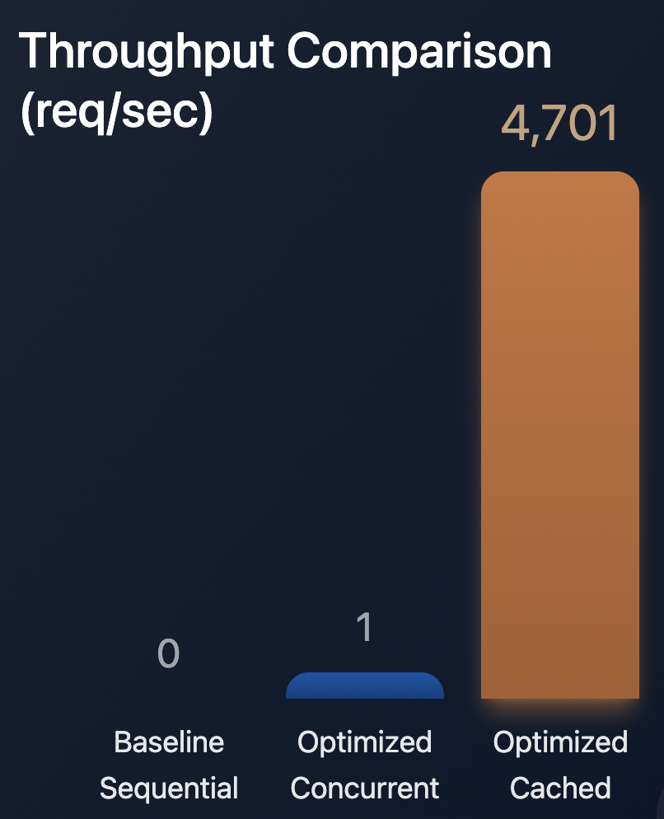
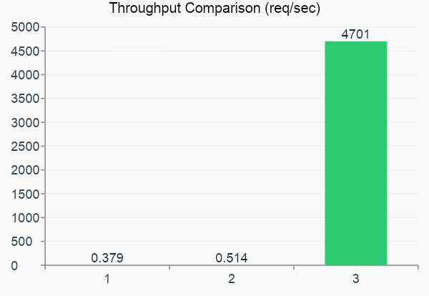
Results: Before vs After
Metric | Baseline | Optimized | Gain
Wall Time (3 req) | 7.924s | 6.571s | ↓ 17%
Throughput | 0.379 req/s | 0.514 req/s | ↑ 36%
Cached Throughput | 0.379 req/s | 4701 req/s | ↑ 12,000x
Repeat Query Time | 2.641s | 0.000s | ↓ 100%
Avg Memory | 33.37 MiB | 30.17 MiB | ↓ 9.6%

Slide 7
Conclusion & Key Takeaways
Caching is the biggest win
Asyncio unlocks parallelism
Repeat queries go from 2.64s → 0ms. For production agents handling similar prompts, caching is essential.
Concurrent requests reduced wall time 17%. The LLM API is the bottleneck — not Python — so async maximizes throughput.
Connection pooling matters
cProfile reveals the truth
TCPConnector with keepalive + DNS caching reduced per-request overhead and improved throughput by 36%.
tottime=0.000 for all Python functions proved the bottleneck is network I/O, guiding us to the right optimizations.
Future Work: Persistent Redis cache · Auto-scaling farm workers · Numba for serialization · Request batching

Slide 8
☕
Thank You
Group 27 · Deepali Balakrishna Ksheersagar · Aditya Desai
github.com/agntcy/coffeeAgntcy
12,000x
↑36%
↓17%
↓9.6%
Cache Speedup
Throughput Gain
Wall Time
Memory Usage

